Slide 1
iCaddy
Instructional Golf App

Slide 2

Why Golf?
Baby boomers (55+) make up 50% of golfers
Golf promotes upper body strength, frequent activity, and stamina
Notes:
A round of golf can be a 2.5-4 mile walk if no cart, and take 2-3 hours
Hand carts are often available for pulling your clubs, so you can choose to walk without having to carry your golf bag
Practicing involves long, often repetitive hours at the driving range learning your club ranges and achieving a consistent swing for each one
Unintimidating—played socially, new golfers welcome to play
If no improvement, can become discouraging

Slide 3
Why an app?
17% of iPhone users are 55+
13% of iPad users are 55+
No additional hardware, available to anyone with a smartphone
Takes advantage of camera, screen, GPS, familiar interface, development platform
Notes:
iPad—take advantage of the increased screen real estate—buttons and text can be bigger and easier to read
iPhone/other smartphones—more easily it in pocket
Easy to write one base program for both apps, and create user interfaces for each--let user decide which device they prefer
For the purposes of this project, I am concentrating on iPad development

Slide 4
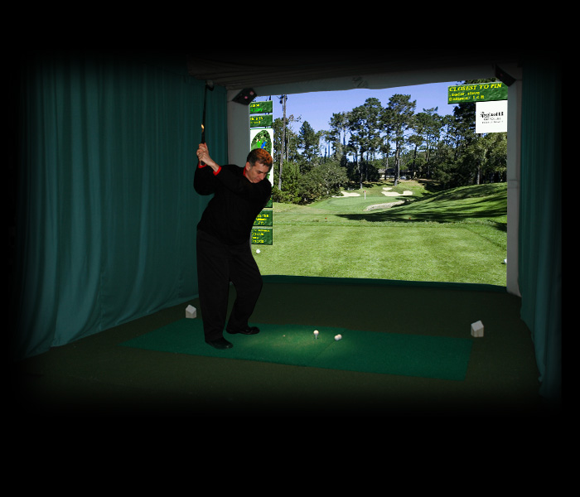
Problem
New golfers don’t like to take lessons
Golfers who do not feel like they’re improving get discouraged and quit
Golf Simulators
Notes:
Golfers don’t like to take lessons
Feel it is ”too expensive”
Often are embarrassed to take lessons
Feel they aren’t improving after one lesson, and therefore don’t take any more
Golf simulators—private experience, can analyze your swing, give you practice without the intimidation factor of being on a real green
Step above driving range, can play a full game. If you slice it to the left, you don’t have to go chase down your ball, or worry about holding up the group behind you, but you can still hit balls and get a feel for the game
Can only go so far, still expensive ($50 for 1 hour)

Slide 5
iCaddy
Club Management Aide
Optical Range Finder
Scorecard
Integrated Instructional Tool

Slide 6
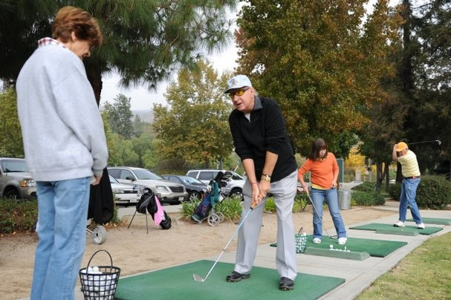
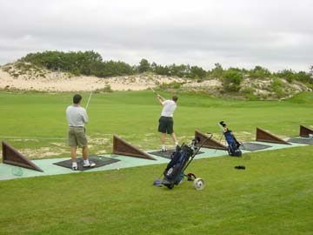
Club Management
Notes:
First, you grab your app and your clubs and head to the driving range
When you feel you have developed a consistent swing, you record your club ranges
This is an activity that many people write down in a notebook. Some people just commit this to memory—this is something you may develop as you become more practiced at the game.

Slide 7
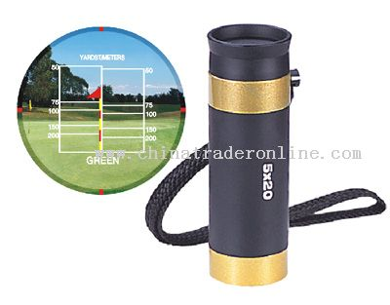
Optical Range Finder
Notes:
The most unique aspect of this app is the Range Finder function.
Range finders on the market today generally fall into one of 3 technologies:
Laser range finders shoot a laser at the green or the pin (flag), and detect how far away it is—most accurate. GPS range finders make you download the course info/layout, and then uses your GPS location to figure out how far you are from the green. Not all courses have this information available
Optical range finders are the cheapest—simply a tube with a lens, with this scale printed on it:
My app is going to take this concept and use the camera to detect how far away you are. It works similar to Optical range finders on the market today, doing some image processing to calculate a pixel height of the flag, and uses a table to convert this into a distance
Now, since it knows how far away the green is and your ranges from your clubs, it can suggest which club to use and why.

Slide 8
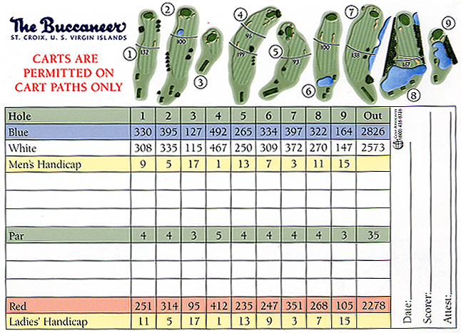
Scorecard

Slide 9

Instructional Tool
Takes your scores and the distances of each swing into account
Suggests tips or tutorials that are customized to user’s game
Notes:
For example, if you are consistently getting onto the green in 2 or 3 swings, but you keep scoring 7s and 8s, it pulls up putting tips
If the app is noticing that you seem to be hitting farther or shorter than your recorded ranges, it brings this to your attention
It later versions, GPS could be integrated. This could be used for range finding, but it could also be used for detecting if you tend to hit to the left or right, and bring up tips to help you straighten your swing out

Slide 10
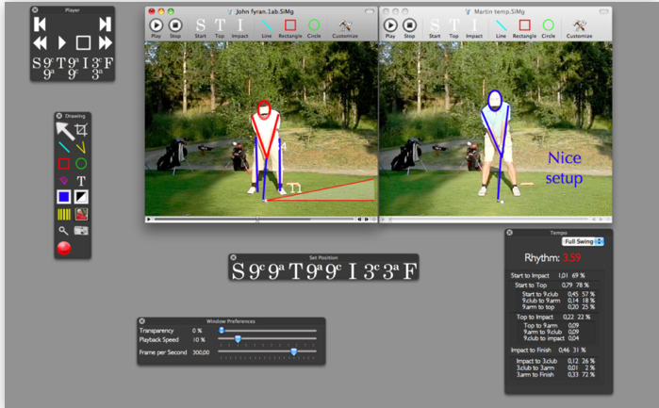
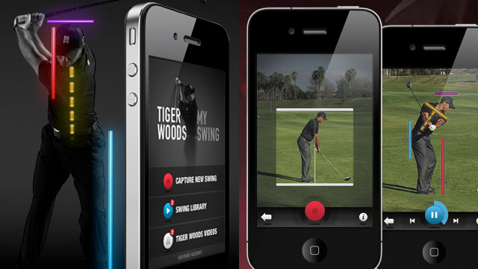
What’s out there
Tiger Woods: My Swing
$9.99
Swing It Pro:
$149.99

Slide 11
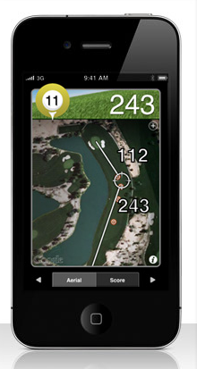
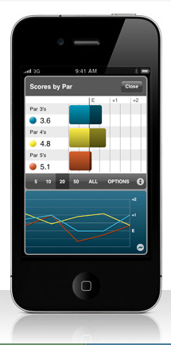

What’s out there
$29.99
Notes:
Same problem with the GPS range finder devices—it won’t have every golf course
What’s worse, it will have every one of the nice, expensive, destination courses—Pebble Beach, Palm Springs, Kapalua, where you can drop a couple hundred dollars for a tee time, but it won’t necessarily have the small, inexpensive course down the street, like Franklin Park, where you can book a tee time for $35
Unfortunately, the latter is going to be more in the price range of golfers just starting out

Slide 12
User feedback
Observation—golf lesson at Natick Golf Learning Center
Informal focus group
Phone interview with dad
Notes:
Listened in on a golf lesson near the indoor driving range

Slide 13
User feedback
Did you take golf lessons when you first learned how to golf?
Do you still take lessons?
What tools did you use when you were first starting out?
How do you remember your ranges for your clubs?
Do you use a range finder while on the course?
Do you have a smart phone?

Slide 14
User feedback
I'm creating an instructional golf app for a class. This app has many parts: First, you take this app to the driving range and record your ranges for your clubs. Then, while you're golfing, you use the app as a range finder by holding the iPhone or iPad toward the green. Similar to an optical range finder, the device uses the camera to measure the height of the pin in the image, and determine how far away the hole is. The device also lets you keep score during the game. Finally, the app combines your score and the measured ranges for your strokes to provide tips customized to your game.
Would you be interested in an app like this?
Are there any features you would expect to be included in such an app?
Is there anything that you do not like or think should be changed for this to be a successful product?

Slide 15
User feedback
“That’s a great idea”
“That doesn’t already exist yet?”
“I would definitely use that if it were free”
“Golfers would pay a lot of money for something like that”
Suggested more tools for the golfer: wind detection
Notes:
2 informal interviews
First with my boyfriend’s parents and their friends at a dinner party—4 couples, everyone over 60
They seemed to really get excited about it, they wanted to know if I would really be developing the app, and to let them know when it was done
One person said, half jokingly, that he would definitely buy it if it were free
Second was an interview with my dad, who is 50
ability to provide tips on how much to compensate for the wind

Slide 16
Project Schedule
Literature Review: February 20th
Knowledge Elicitation: March 5th
Design Requirements: March 9th
Prototype Development: March 23rd
Usability Testing: April 6th
Final Development Iteration: April 20th
Project Deadline: April 30th

Slide 17
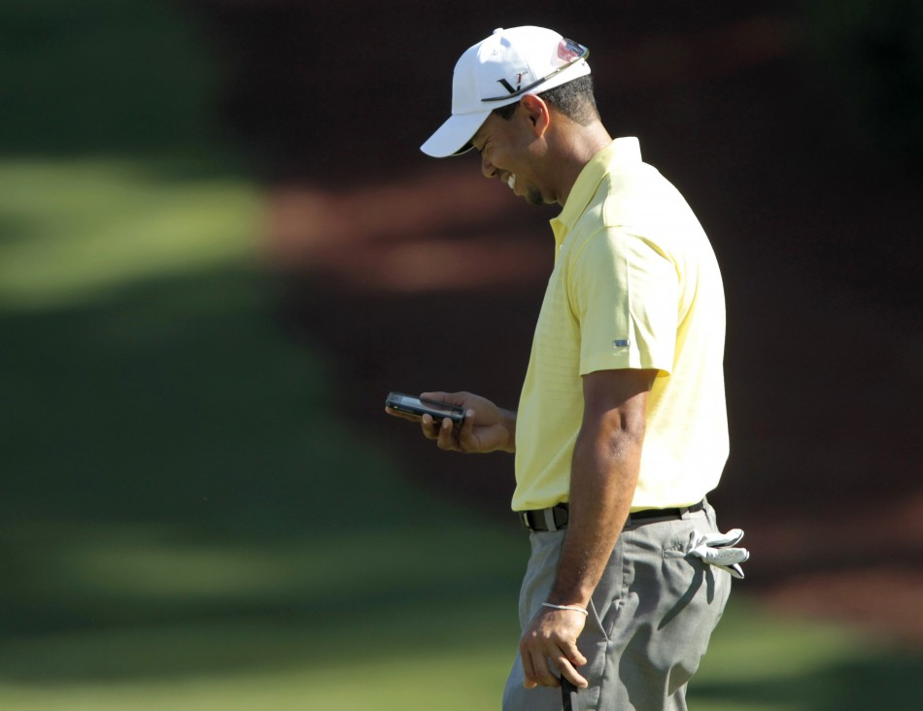
Questions?

